Slide 1

Microsoft’s XNA
Pieter Joost van de Sande
sr. IT consultant & speaker @ Sogyo Microsoft Visual C# MVP boardmember dotNed pjvdsande@sogyo.nl http://born2code.net
26 November 2008

Slide 2
Agenda
Introduction
From zero to hero
Microsoft and gaming
Live demo
Wii-mote
Live demo

Slide 3
From zero to hero
How gaming evolved

Slide 4

Who is this?
Notes:
Who is this guy?

Slide 5
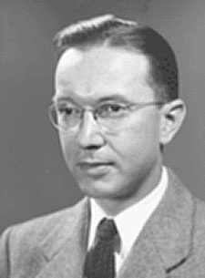
Who is this?
Notes:
Who is this guy?

Slide 6
Who is this?
William Higinbotham
Notes:
William Higinbotham, Physicist at Brookhaven lab
Born October 25, 1910
Died November 10, 1994
Famous for creating Tennis for Two

Slide 7
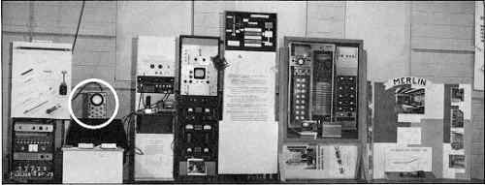
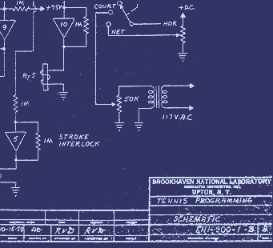
First video game, 1958
Notes:
Brookhaven lab
oscilloscope

Slide 8
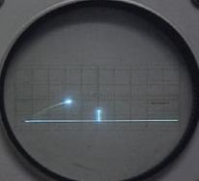
First video game, 1958
Notes:
Release date: October 18, 1958
Platform: Analog computer / Oscilloscope

Slide 9
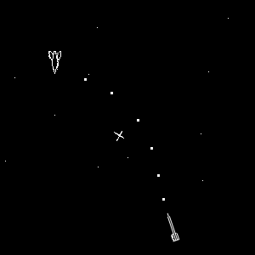
Spacewar!, 1962
Notes:
First worldwide game

Slide 10
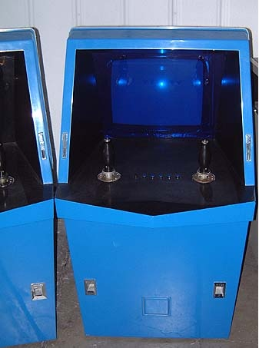
The Galaxy Game, 1971
Notes:
First arcade machine
Homecomputers where rare because they where to expensive
This hardware costs: $20,000
One game costs: $0.10

Slide 11
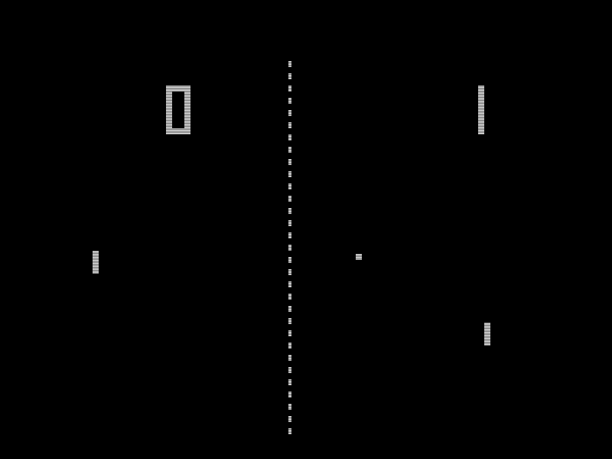
Pong, 1972

Slide 12
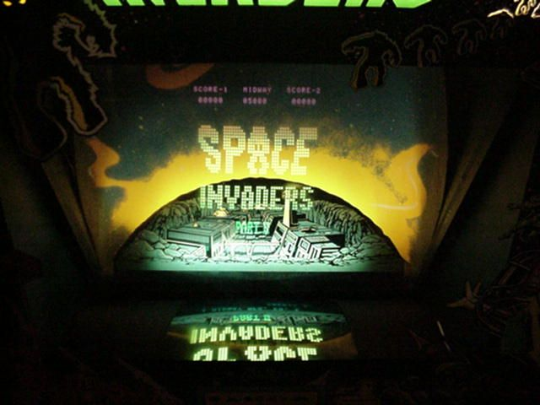
Spaceinvader, 1978

Slide 13

Commodore, 1982

Slide 14
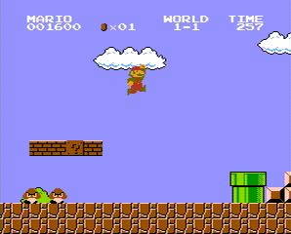
Super Mario Bros, 1985
Notes:
Console markt!

Slide 15
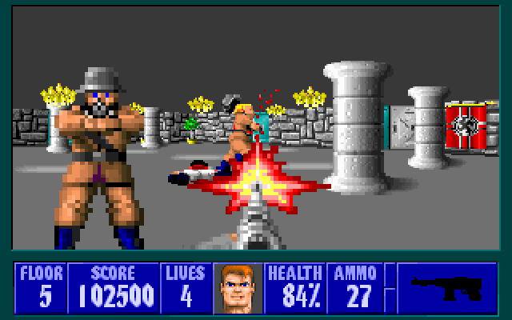
Wolfenstein 3D, 1992
Notes:
PC Markt

Slide 16
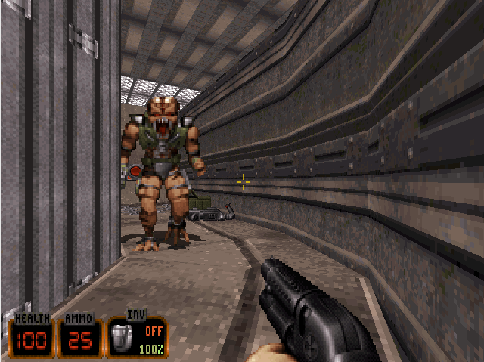
Duke Nukem 3D, 1996

Slide 17

Call of Duty 4, 2007
Notes:
Multiplatform
Het is een mega business

Slide 18

GT5 prologue, 2008
Notes:
Multiplatform
Het is een mega business

Slide 19
Gaming today
Trends

Slide 20

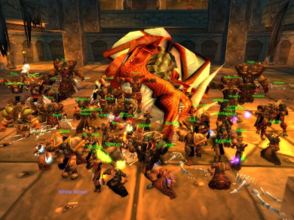



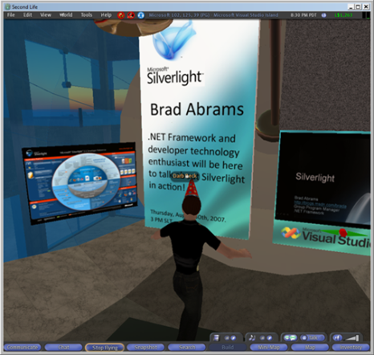
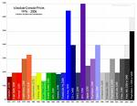

Facts
Halo 3, first 24 hours
$ 170 miljoen
World of Warcraft [2007]
$ 1.176 milliard
USA [2007]
$ 17.9 miljard
Ubisoft 2007
$ 662.7 million
NL Game industie
$ 1.47 milliard
NL game industrie larger then music
NL game industrie larger then film
Second Life
$5 million a month
Notes:
WOW, $1.2 miljard
Halo3, in 24 uur, $170 miljoen
Second Life, $5 miljoen

Slide 21
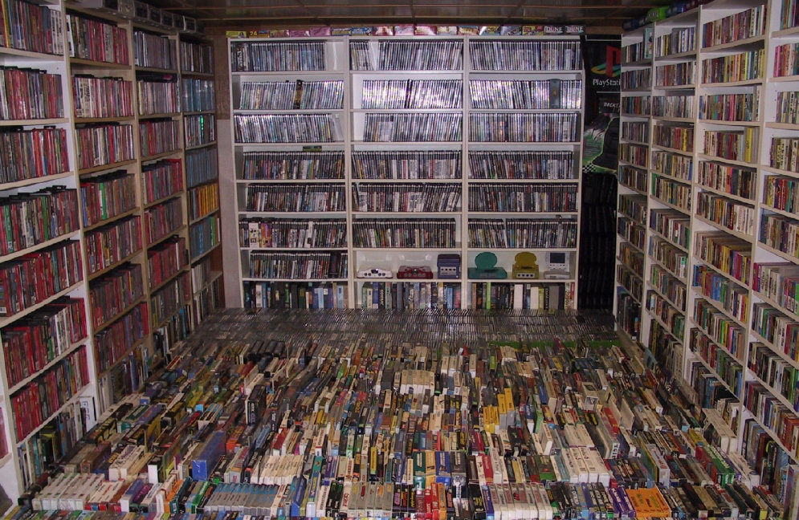
Gaming business is huge
Notes:
Gaming is huge

Slide 22

Everybody is gaming
Notes:
Grandma is gaming to!

Slide 23
Super realistic
Notes:
Multiplatform
Het is een mega business

Slide 24
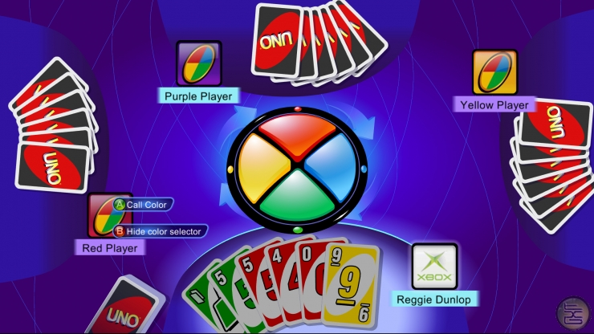
Simple, but a lot of $$$

Slide 25
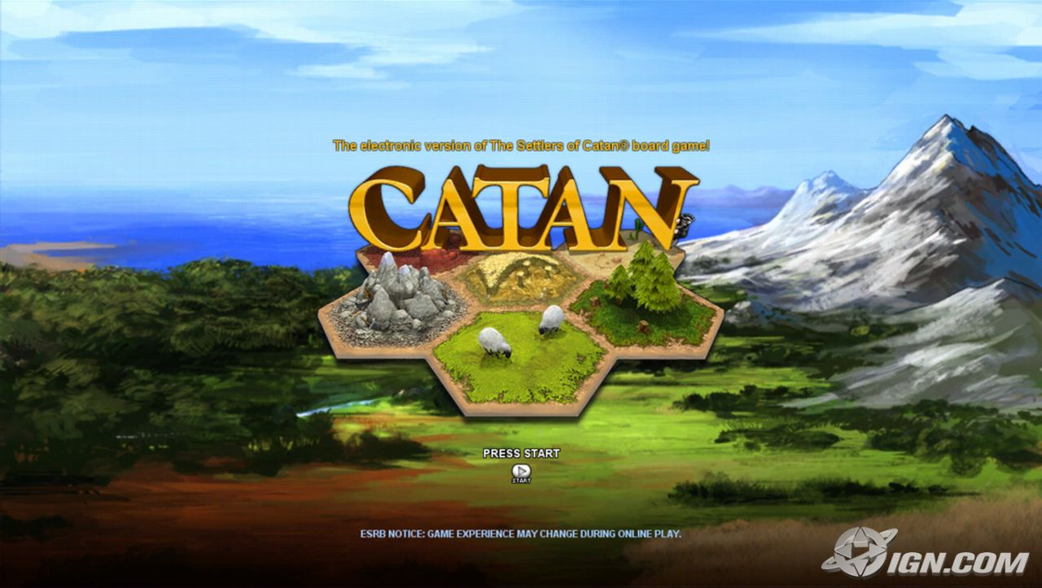
Simple, but a lot of $$$

Slide 26
Gaming and Microsoft
How is Microsoft related to this?

Slide 27
Microsoft & gaming
What's the biggest gaming platform in the world?
Notes:
Windows, biggest gaming platform of the world

Slide 28

Microsoft & gaming
Microsoft’s Windows
Notes:
Windows, biggest gaming platform of the world

Slide 29

Microsoft & gaming
Microsoft’s Windows
Microsoft’s DirectX
Notes:
Microsoft created Direct X to give developers a 'simple' and 'standard' API
Supports multiple versions of Windows

Slide 30

Microsoft & gaming
Microsoft’s Windows
Microsoft’s Xbox
Microsoft’s DirectX
Notes:
Microsoft entered the console marked in 2001.
Xbox sold 24 million

Slide 31

Microsoft & gaming
Microsoft’s Windows
Microsoft’s Xbox
Microsoft’s DirectX
Microsoft’s Xbox 360
Notes:
Xbox 360 released in 2005
22 million sold

Slide 32

Microsoft & gaming
Microsoft’s Windows
Microsoft’s Xbox
Windows Mobile
Microsoft’s DirectX
Microsoft’s Xbox 360
Notes:
Windows Mobile, 18 million in 2008
40 million cell phones with Windows Mobile

Slide 33

Microsoft & gaming
Microsoft’s Windows
Microsoft’s Xbox
Microsoft’s Zune
Windows Mobile
Microsoft’s DirectX
Microsoft’s Xbox 360
Notes:
Zune, introduced in 2006
+2 million units sold begin 2008

Slide 34
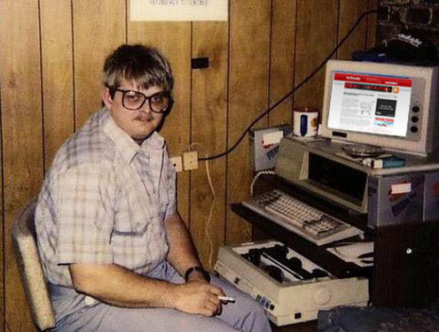
Game programming is hard

Slide 35

XNA makes development easy

Slide 36

Demo time!
Create a game in ±60 minutes

Slide 37
Demo time!
You can be part of it

Slide 38
XNA overview
Theorie

Slide 39
XNA
Set of tools for game development
Managed environment
One big platform
Makes game development easy
Notes:
Set tools
Managed environment
Alle aspecten in 1 systeem
Toegankelijk!

Slide 40
XNA Platform

Slide 41
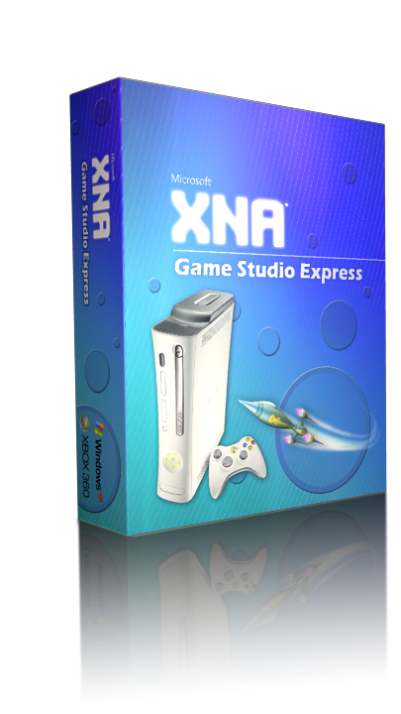

XNA Game Studio
XNA Game Studio Express
non-commercial game development
XNA Game Studio Professional
Commecial license
Not available yet

Slide 42
XNA Framework
Microsoft .NET CLR 2.0
Cross-Platform Game Development
Windows XP
Windows Vista
Xbox 360 ☺
Easy to learn and self explaining API
Notes:
Microsoft .NET 2.0
Multiplatform

Slide 43









XNA Framework Overzicht
Games
Starter Kits
Code
Content
Components
Extended
Framework
Application Model
Content Pipeline
Core
Framework
Graphics
Audio
Input
Math
Storage
Platform
Direct3D
XACT
XINPUT
XContent
Legend
XNA Provides
You Provide
Community
Notes:
Legenda

Slide 44
XNA Framework Overzicht
Games
Starter Kits
Code
Content
Components
Extended
Framework
Application Model
Content Pipeline
Core
Framework
Graphics
Audio
Input
Math
Storage
Platform
Direct3D
XACT
XINPUT
XContent
Legend
XNA Provides
You Provide
Community
Notes:
Games – JIJ!
Hier leeft jouw code
3rd party (components)

Slide 45
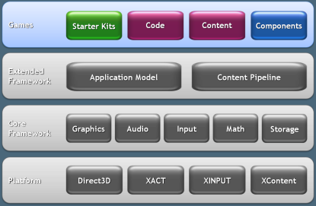

Starter Kits
“Take our games and make them your own”
Complete game
Starting point
Hit F5 and run
Documentation and tutorials
Availability
Free
Microsoft will continue and create more
Notes:
Volledige game!
Het is een voorbeeld
Kan als basis dienen
F5 & run!

Slide 46
Components
Intergrates within the gameloop
Initialize, Load, Update, Draw, Unload
Create and reuse code
3rd party components
Community has a standard
Menus, virtual keyboard, game engine, game info, radar’s, map, etc…
Notes:
Hergebruik!
Standaarden!
Menu’s, keyboards, phisycs, radar…
Support vanuit het framework
Game class gebruikt het
Drawable vs. Nondrawable

Slide 47
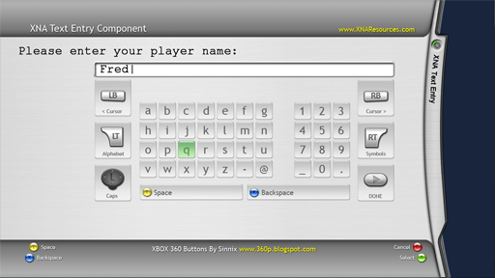
Components
Example
Virtual keyboard for XBOX 360

Slide 48
XNA Framework Overzicht
Games
Starter Kits
Code
Content
Components
Extended
Framework
Application Model
Content Pipeline
Core
Framework
Graphics
Audio
Input
Math
Storage
Platform
Direct3D
XACT
XINPUT
XContent
Legend
XNA Provides
You Provide
Community

Slide 49
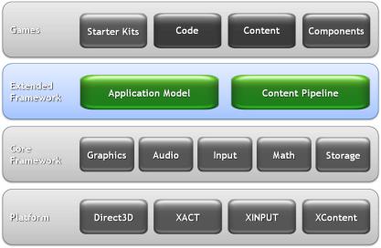
Application Model
Platform abstraction
Don't worry about the platform
First line of code is for you game
Game class
Easy startpoint

Slide 50
Application Model
Game Class, startpunt van je game
Game
Initialize
LoadContent
Update
Draw
UnloadContent
GameComponent, DrawableGameComponent
Notes:
Game class, startpunt
Device handles? ☺
Standaard gameloop
Basis classes:
GameComponent
DrawableGameComponent
Ook components zijn bekend met deze loop!

Slide 51
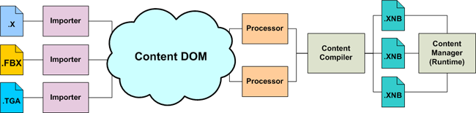
Content Pipeline
Extensible content processing framework
2D File Formats (.DDS, .BMP, .JPG, .PNG, .TGA)
3D File Formats (.FBX, .X)
Material File Formats (.FX)
Audio File Formats (.XAP)
Notes:
Content, welk type?
Eigen importer:
3D level genereren adhv textfile?
3D level genereren adhv headmap?
Content DOM (repository)
Processor:
Y = up, niet Z (3DSMAX)
Greyscale
Centreren

Slide 52
XNA Framework Overzicht
Games
Starter Kits
Code
Content
Components
Extended
Framework
Application Model
Content Pipeline
Core
Framework
Graphics
Audio
Input
Math
Storage
Platform
Direct3D
XACT
XINPUT
XContent
Legend
XNA Provides
You Provide
Community
Notes:
Voeding voor het extended framework
Laagste laag in XNA
Helpers
Emulatie (Storage & Network)

Slide 53
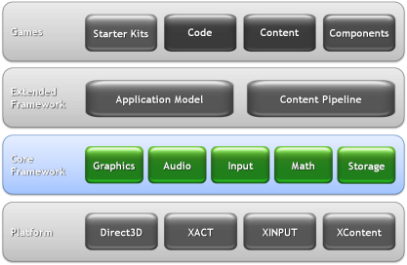
Core Framework
Graphics
SpriteBatch, BasicEffect, Texture2d, GraphicsDevice, Model, VertexBuffer
Audio
SoundBank, WaveBank, Cue, AudioEngine
Looping, Streaming en memory management
low-level buffer management
Input
GamePad, Keyboard, Mouse

Slide 54
Core Framework
Math
MathHelper.ToRadians(float angle), PiOver4
Storage
Title Storage (Shaders, Meshes, Textures, Sounds…)
User Storage (Save games, Scores…)
Wordt geëmuleerd op het Windows Platform
Network
NetworkSession, PacketReader, NetworkGamer

Slide 55
XNA Framework Overzicht
Games
Starter Kits
Code
Content
Components
Extended
Framework
Application Model
Content Pipeline
Core
Framework
Graphics
Audio
Input
Math
Storage
Platform
Direct3D
XACT
XINPUT
XContent
Legend
XNA Provides
You Provide
Community

Slide 56
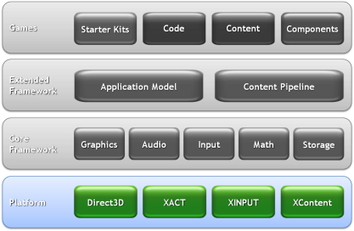
Platform abstractie
Varies for each platform
Mono already provides a implementation

Slide 57
XACT
Microsoft Cross-Platform Audio Creation Tool
Enable audio for your games
Compiles .wav files
Add information to sounds
Looping, volume levels

Slide 58


Community
3D Models
Cars, Houses, humans, complete levels
Lot of them are free
http://turbosquid.com/xna

Slide 59
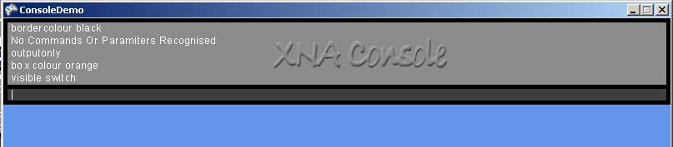
Community
Example of a component
XNA Console

Slide 60
Deploy to the Xbox 360
XNA Creators Club
49 euro 4 months
99 euro 1 year
What do you need on your Xbox 360?
Xbox Live Account
XNA Game Launcher
Connection to the computer

Slide 61

XNA++, whats next?
Support for Visual Studio 2008
Support for Zune player
Support for Linux
Support for Mac OSX

Slide 62
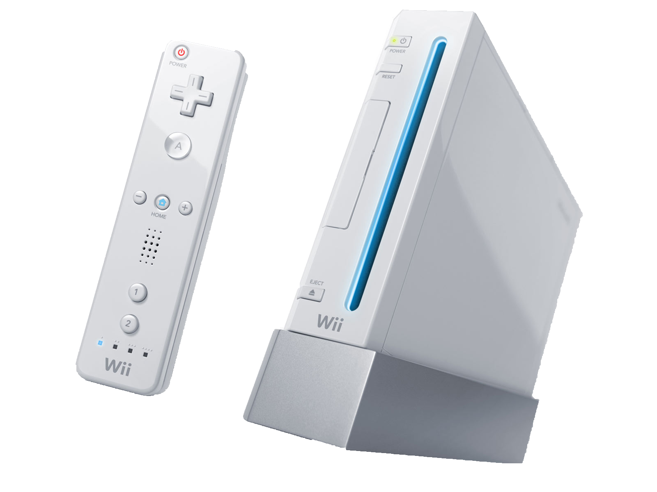
Nintendo’s Wii!
Notes:
Nintendo
Released 2006
Geen Uber resoluties
Wel de wiimote

Slide 63
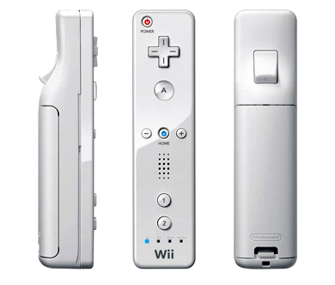
Wiimote
Buttons
Accelerometer
IR-camera
Buzzer
Leds
Bluetooth

Slide 64
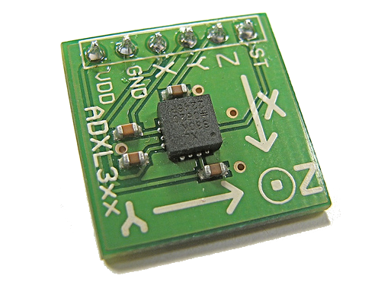
Accelerometer
ADXL330 3-Axis ±3g iMEMS® Accelerometer
Notes:
Hoe werkt de accelerometer
X, Y en Z meting.
Genormaliseerd op 1G. Maximale uitslag van +- 3 G
Wat meet je als je hem recht houdt, op zijn kop houdt of beweegt

Slide 65
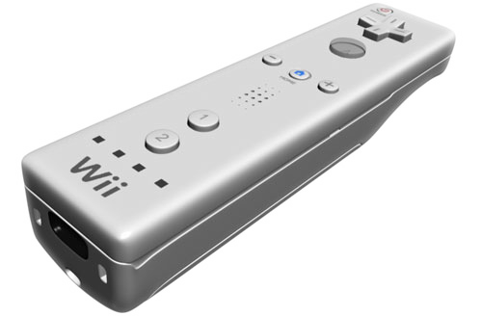
Accelerometer
Y (-3G,3G)
Z (-3G, 3G)

Slide 66
Accelerometer
0
Idle
0
1

Slide 67
Accelerometer
0
Up
0
>1

Slide 68
Accelerometer
0
Down
0
<1

Slide 69
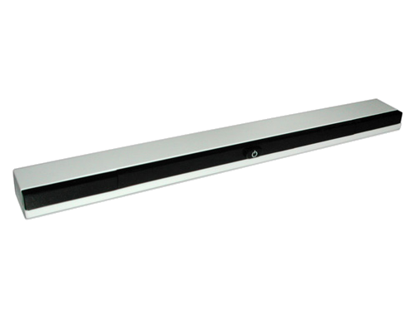
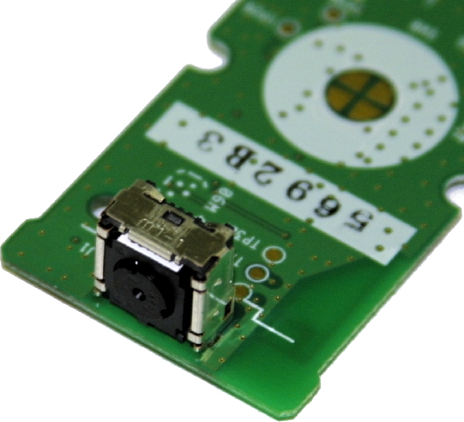
IR-camera
PixArt optical sensor Multi-Object Tracking engine (MOT sensor™)
Sensor bar
Notes:
Krachten meten is nuttig. Maar preciese positie is moeilijk te bepalen.
Daarom IR-Camera:
Samenwerking met LED balk
2 led puntjes (sensor kan 4 aan)
Meting positie van wiimote inclusief draaihoek

Slide 70
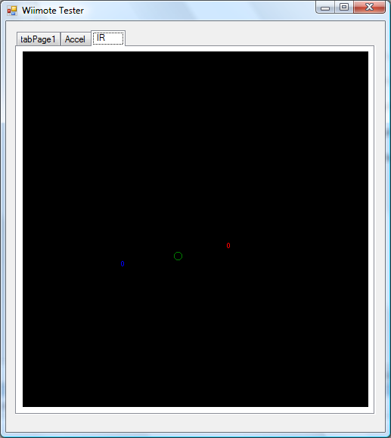
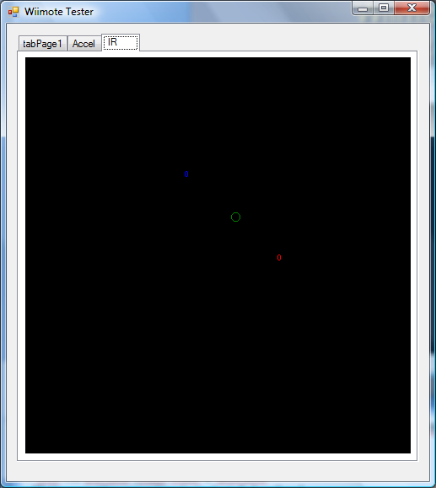
IR-camera
Notes:
Met 2 punten positie en hoek bepalen
+ bewegingen van of naar sensorbar door wijzigen afstand punten tot elkaar.

Slide 71
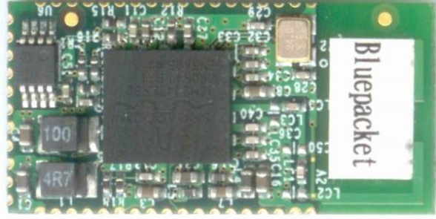
Bluetooth
BCM2042 Advanced Wireless Keyboard/Mouse Bluetooth® Chip
HID Device
Notes:
Communicatie met Wii via bluetooth
Chipset ook gebruikt bij muis en toetsenbord
Manifesteert als HID device

Slide 72
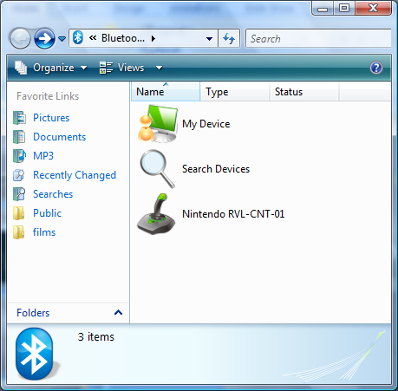
Wiimote -> PC
OS
Bluetooth Device
Bluetooth stack
Notes:
Goede combinatie OS, Bluetooth hardware en Bluetooth stack en connecten maar
Wiimote wordt gezien als HID Game device

Slide 73
API’s
wiimote-api
RMX Automation
WiimoteLib
GlovePIE
WiinRemote
libwiimote
WMD
Wiiewer
WiimoteCPP
WiiYourself!
Wiimotecomm
Notes:
Connectie met PC gelegd. En nu nog communicere
Veel libraries voor allerlei toepassingen en talen
WiimoteLib perfect voor .Net.

Slide 74
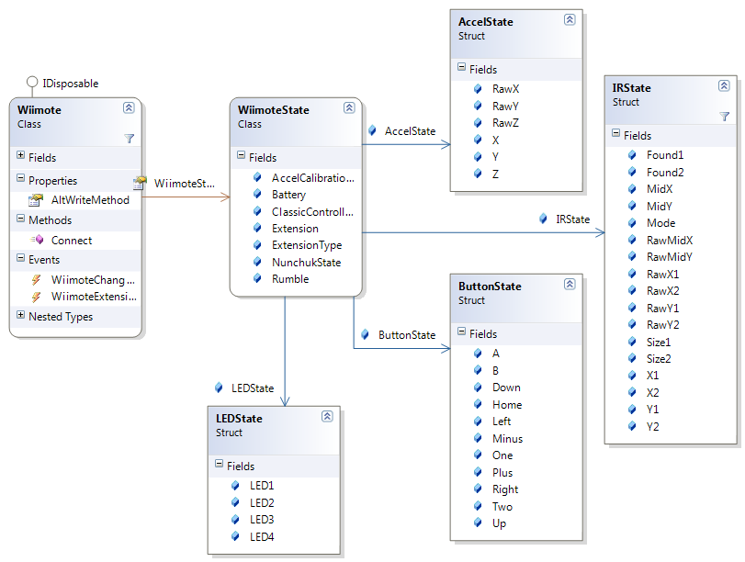
WiimoteLib classes

Slide 75
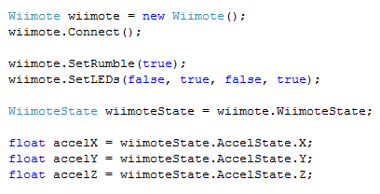
Simplicity

Slide 76
Demo time!
Flying with the Wii

Slide 77
Resources
http://creators.xna.com/
http://blogs.msdn.com/xna
http://www.turbosquid.com/xna
http://xbox360homebrew.com
http://www.riemers.net
http://www.xnadevelopment.com
Search for XNA at Google with Live Search

Slide 78

Questions?

